Slide 1
University physics, classical mechanics. Lesson 6: Momentum and impulse
Teacher: Dr. Paul Briard
Wechat: Paulbg123
Notes:
PARLER LENTEMENT: Hello everybody ! For this sixth lesson of university physics, we will discuss about momentum and impulse.

Slide 2
Contents
Introduction
The momentum
Notes:
PARLER LENTEMENT: After a short instruction, we will see what is the momentum of a particle. Maybe you already have a little idea of what is a momentum.

Slide 3
Contents
Introduction
The momentum
The impulse-momentum theorem
Notes:
PARLER LENTEMENT: Then I will describe you what is the impulse and the relationship between momentum and impulse which described by the impulse-momentum theorem. As maybe you know, the impulse is related with the contact forces between bodies in collisions, for instance.

Slide 4
Contents
Introduction
The momentum
The impulse-momentum theorem
Elastic and inelastic collisions
Notes:
PARLER LENTEMENT: And after that, I will describe you elastic and inelastic collisions. The concept of momentum is useful to describe collisions between bodies.

Slide 5
Contents
Introduction
The momentum
The impulse-momentum theorem
Elastic and inelastic collisions
Center of mass of any body
Notes:
PARLER LENTEMENT: We have seen together how to describe the motion of a particle which is an ideal point-like body. But how to describe the motion of a body which is not a particle ? We have to describe the motion of its center of mass. Thus, I will profit of this lesson to describe you the center of mass of a body. This will be very useful later.

Slide 6
1. Introduction
Notes:
PARLER LENTEMENT: But first, let’s introduce the concept of momentum,

Slide 7
Introduction: The Newton’s cradle
Case 1:
A
B
A
B
We consider two iron balls of same mass. We release the iron ball A. What’s happens ?
Notes:
PARLER LENTEMENT: For this introduction, let’s imagine a little experiment, which is the Newton cradle. We consider to iron balls A and B of same mass. Both balls are suspended at vertical strings. Then, with the hand, we move the iron ball A, and we release it. What happens to motion of both iron balls ?

Slide 8
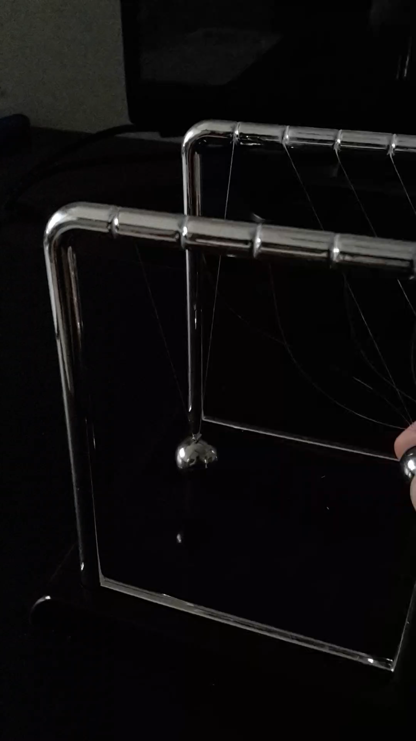
Introduction: The Newton’s cradle
Case 1:
Notes:
PARLER LENTEMENT: Let’s see what happens with this video. (LANCER LA VIDEO). You can see that the second iron ball who was almost at rest get a circular motion, due to the fact it was suspended at strings. Then it come back to its position at rest but have a collision with the other ball. And so on, and so on. I don’t show it on this video, but after few minutes, the amplitude of the circular motion will decrease and the both iron balls will stop to move. This is because of the friction. For most cases in this lesson, we will ignore the friction. As if this motion was perpetual.

Slide 9
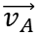
Introduction: The Newton’s cradle
Case 1:
A
$$\vec{v_{A}}$$
B
Velocity vector
Notes:
PARLER LENTEMENT: Now let’s describe what happens in terms of velocity vector. First, the ball A is at the top, and just after been released, the ball A has zero velocity. But then the ball is falling with a circular motion, it has a certain velocity vector v_A. Take care that here, the motion is not a uniform circular motion. The velocity increase when the ball A falls on the ball B.

Slide 10
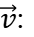
Introduction: The Newton’s cradle
Case 1:
$$\vec{v_{A}}$$
A
B
$\vec{v}$:
Velocity vector
Notes:
PARLER LENTEMENT: A short time after, the ball A is close to the ball B.

Slide 11
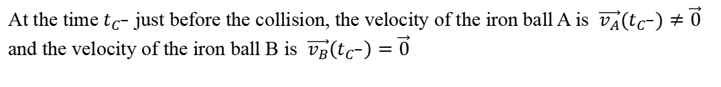
Introduction: The Newton’s cradle
Case 1:
B
$\vec{v}$:
Velocity vector
A
$$\vec{v_{A}}$$
At the time $t_{C^{−}}$ just before the collision, the velocity of the iron ball A is $\vec{v_{A}}(t_{C^{−}})≠\vec{0}$ and the velocity of the iron ball B is $\vec{v_{B}}\left(t_{C^{−}}\right)=\vec{0}$
Notes:
PARLER LENTEMENT: And finally, the ball A come into contact with the ball B. When they are in contact with each other, there is a normal force exerted between the balls, has we have described few weeks ago. Just before the contact between the ball, at time t_C_minus, The ball A has a certain velocity. And the ball B has a velocity zero, it is still at rest. I say “C” in time tC for the time when there is the collision, and t_C_minus for the time just before the collision.

Slide 12
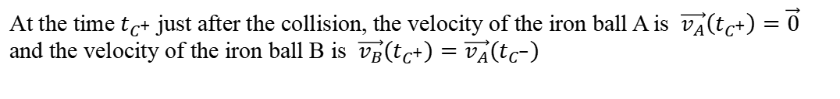
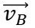
Introduction: The Newton’s cradle
Case 1:
B
$\vec{v}$:
Velocity vector
A
$$\vec{v_{B}}$$
At the time $t_{C^{+}}$ just after the collision, the velocity of the iron ball A is $\vec{v_{A}}\left(t_{C^{+}}\right)=\vec{0}$ and the velocity of the iron ball B is $\vec{v_{B}}\left(t_{C^{+}}\right)=\vec{v_{A}}\left(t_{C^{−}}\right)$
Notes:
PARLER LENTEMENT: And at the time just after the collision, the time t_C_plus, the ball A is at rest, its velocity is zero. The velocity vector of ball B just after the collision is the velocity of ball A just before the collision. This is a particular case, due to the fact that both balls have the same mass.

Slide 13
Introduction: The Newton’s cradle
Case 1:
$$\vec{v_{B}}$$
B
$\vec{v}$:
Velocity vector
A
Notes:
PARLER LENTEMENT: And finally, the ball A stay at rest, and the ball B has a circular motion. I don’t describe you more details about this circular motion, it is something we will see later. I just use this experiment to show you that something has been transmitted from ball A to ball B during the collision. This something is involved with the velocity of the balls. It is also related with the direction of the motion, described by the direction of the velocity vector.

Slide 14
Introduction: The Newton’s cradle
Case 2:
A
B
C
D
E
What happens in that situation after the collision between ball B and ball C ?
Notes:
PARLER LENTEMENT: Here is another experiment. This time, there are 5 iron balls of same mass. We move together two balls A and B. Both balls A and B have same motion, which is a circular motion as previously. What happens in that situation after the collision between ball B and ball C ?

Slide 15
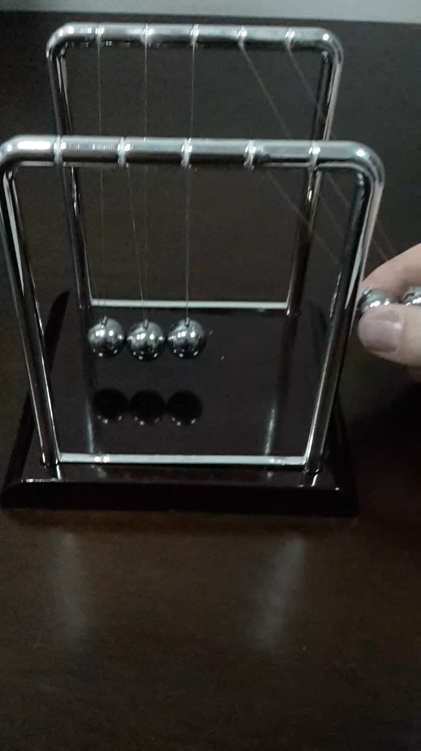
Introduction: The Newton’s cradle
Case 2:
Notes:
PARLER LENTEMENT: Let’s see what happens with this video. LANCER VIDEO. You can see that the ball C at the middle stay almost at rest. And then the both balls a the left are in circular motion when the three balls at the right stay at rest until the next collision. It is quite interesting to see that after the collision, it is not one ball or three balls which have circular motion, but 2 balls. So, not only the velocity is important and is transmitted, but also the “number of balls which were moving before the collision”. We can consider a group of two ball moving together as a single body which have a certain mass, And what happens after the collision depends to the mass.

Slide 16
Introduction: The Newton’s cradle
In all of these cases, there is transmission of the momentum of a system to another system.
The momentum is a particularly useful tool to study the collisions
Notes:
PARLER LENTEMENT: When we study collisions between bodies, we cannot consider only the velocity. We have see how the mass of system which has collision with another system is important to consider. And what have been transmitted is what we call the momentum. In the last experiment, it was the momentum of the system ball A + ball B, which has been transmitted to ball C, which has been transmitted to ball D +E, and so on. The momentum is very useful tool to study the collisions between bodies.

Slide 17
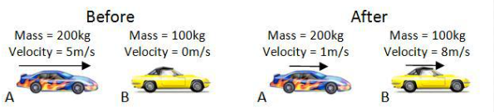
Momentum is used to describe collisions between bodies
Notes:
PARLER LENTEMENT: Here are two examples with collisions between bodies. At the top, the car A has a certain velocity and mass. The car B is at rest before the collision. Then after the collision, the car A as a certain velocity, smaller than before the collision. The car B get a certain velocity, You see that the car A is not at rest and the car B velocity is not the velocity of car A before the collision. This is involved with the mass of both cars which is not the same in this example.
. When you play snooker, you do the same thing, You stick transmit a momentum to a ball, which transmit his momentum to another ball, and so on.

Slide 18
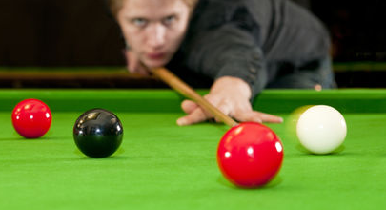
Momentum is used to describe collisions between bodies
Notes:
PARLER LENTEMENT: Here is another example of collisions. When you play snooker, your stick transmit a momentum to a ball, which transmit his momentum to another ball, and so on.

Slide 19
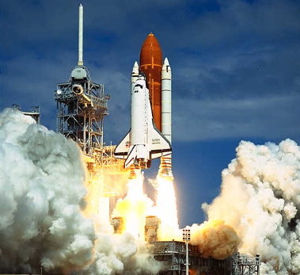
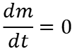
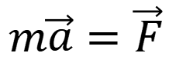
Introduction (2): How to deal with a system which the mass change with the time ?
$$m\vec{a}=\vec{F}$$
Newton’s 2nd law:
Net force on the system
Mass constant with the time:
acceleration
$$\frac{dm}{dt}=0$$
Example of the rocket: it lost the propellant (which have a mass) which permits the propulsion
Notes:
PARLER LENTEMENT: Here is another reason why we have to consider the momentum. But here is no collision. We have seen few weeks ago the Newton’s second law. The net force on a body is the production between the mass of the body and the acceleration. But in that case, we consider the mass of the body is constant. But what happens if we want to describe the motion of this rocket for instance, which has a mass which is not constant. There is a part of propellant which is used for the propulsion of the rocket which is lost by the rocket. In this situation also we will have to describe the momentum.

Slide 20
2. The momentum
Notes:
PARLER LENTEMENT: After this introduction, let’s describe the momentum.

Slide 21
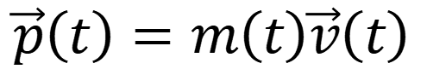
Expression of the momentum
$$\vec{p}\left(t\right)=m\left(t\right)\vec{v}\left(t\right)$$
Momentum
Velocity of the particle studied
Mass of the particle studied
Notes:
PARLER LENTEMENT: So here is the expression of the momentum. In could depends to the time so, this is why the time t is in this equation. For the moment, we consider only particles, but we will see later how to describe the momentum of any body. The momentum is simply the product between the mass and the acceleration. You can see that in this equation, the mass of the body could change with time, as for the case of the rocket I have described you, The momentum of a particle is a vector which has same direction than the velocity vector. And the bigger is the mass, the bigger is the magnitude of the momentum.

Slide 22
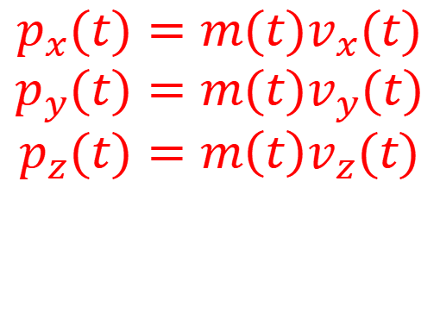
Expression of the momentum
$$\vec{p}\left(t\right)=m\left(t\right)\vec{v}\left(t\right)$$
Momentum
Velocity of the particle studied
Mass of the particle studied
In a 3D Cartesian coordinate system:
$$p_{x}(t)=m(t)v_{x}(t)$$
$$p_{y}(t)=m(t)v_{y}(t)$$
$$p_{z}(t)=m{\left(t\right)v}_{z}(t)$$
Notes:
PARLER LENTEMENT: to describe the momentum, instead of to use one equation with vectors, we can use three equations describing each component of the momentum. In 3D Cartesian coordinates, you can see the describe of the x, y, and z components of the momentum. It is the mass multiplied by the corresponding component of the velocity vector. In this slide I say the mass and the velocity vector depends to the time, so later I will use these equations but omit the time t in them.

Slide 23
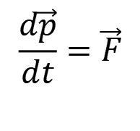
Momentum in the Newton’s 2nd law
$$\frac{d\vec{p}}{dt}=\vec{F}$$
Net force exerted on the particle
Change rate of the momentum of the particle
Notes:
PARLER LENTEMENT: We can also describe what is the change rate of the momentum, which is the ratio between the infinitesimal change of momentum during infinitesimal time interval dt divided by dt. It is simply the net force exerted on the particle. Here you see the Newton’s second law which describe the momentum of a particle, or more accurately how change this momentum during the motion of a particle,

Slide 24
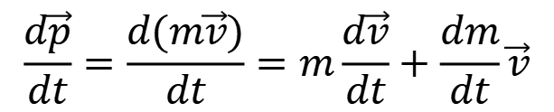
Momentum in the Newton’s 2nd law
$$\frac{d\vec{p}}{dt}=\vec{F}$$
Net force exerted on the particle
Change rate of the momentum of the particle
$$\frac{d\vec{p}}{dt}=\frac{d(m\vec{v})}{dt}=m\frac{d\vec{v}}{dt}+\frac{dm}{dt}\vec{v}$$
Notes:
PARLER LENTEMENT: Lets give more details about the change rate of the momentum dp divided by dt. We put here the expression of the momentum as the mass multiplied by the velocity of the particle. We obtain a sum of two terms. The first one is the mass multiplied by the acceleration dv divided by dt. The second term is the velocity vector of the particle multipled by the change rate of the mass of the particle.

Slide 25
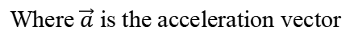
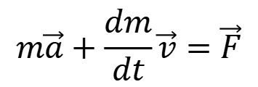
Momentum in the Newton’s 2nd law
$$\frac{d\vec{p}}{dt}=\vec{F}$$
Net force exerted on the particle
Change rate of the momentum of the particle
$$\frac{d\vec{p}}{dt}=\frac{d(m\vec{v})}{dt}=m\frac{d\vec{v}}{dt}+\frac{dm}{dt}\vec{v}$$
$$m\vec{a}+\frac{dm}{dt}\vec{v}=\vec{F}$$
Where $\vec{a}$ is the acceleration vector
Notes:
PARLER LENTEMENT: Thus, we obtain something similar to the Newton’s second law you already know. But here there is a new term to take care , which depends on the change rate of the mass of the particle.

Slide 26
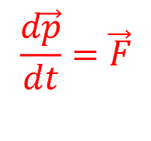
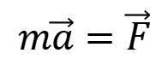
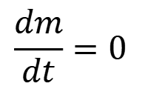
Momentum in the Newton’s 2nd law
$$\frac{d\vec{p}}{dt}=\vec{F}$$
Net force exerted on the particle
Change rate of the momentum of the particle
$$\frac{d\vec{p}}{dt}=\frac{d(m\vec{v})}{dt}=m\frac{d\vec{v}}{dt}+\frac{dm}{dt}\vec{v}$$
$$m\vec{a}+\frac{dm}{dt}\vec{v}=\vec{F}$$
Where $\vec{a}$ is the acceleration vector
$$\frac{dm}{dt}=0$$
If the mass is constant with the time, then
$$m\vec{a}=\vec{F}$$
Notes:
PARLER LENTEMENT: In the case of the mass is constant with time, which is most of cases we will consider, then the infinitesimal change of mass dm is zero and we obtain the Newton’s second law you already know.

Slide 27
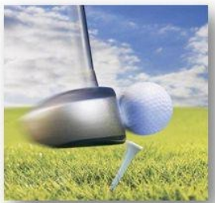
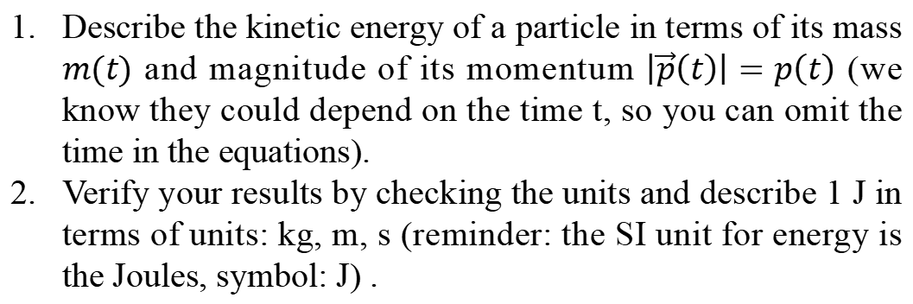
Ex. Kinetic energy and momentum (5 minutes)
After the impact, this golf ball has a certain momentum and a certain kinetic energy.
Describe the kinetic energy of a particle in terms of its mass $m(t)$ and magnitude of its momentum $\left|\vec{p}\left(t\right)\right|=p\left(t\right)$ (we know they could depend on the time t, so you can omit the time in the equations).
Verify your results by checking the units and describe 1 J in terms of units: kg, m, s (reminder: the SI unit for energy is the Joules, symbol: J) .
Notes:
PARLER LENTEMENT: Here is a short exercise of description of the kinetic energy. By using what we have seen together, please to describe the kinetic energy in terms of the magnitude of momentum. Take care that the kinetic energy is a scalar. After that, please to check everything is right about the units, I remind you that the SI unit of the energy is the Joule. Please also to describe me what is 1 joule in terms of base SI units.

Slide 28
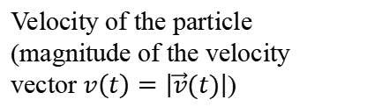
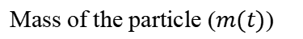
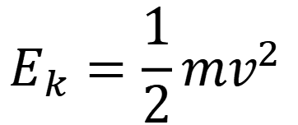
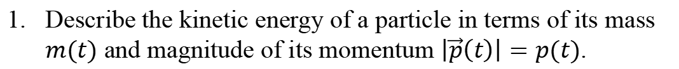
Solution
Describe the kinetic energy of a particle in terms of its mass $m(t)$ and magnitude of its momentum $\left|\vec{p}\left(t\right)\right|=p(t)$.
Kinetic energy of a particle:
$$E_{k}=\frac{1}{2}mv^{2}$$
Velocity of the particle (magnitude of the velocity vector $v\left(t\right)=\left|\vec{v}(t)\right|$)
Mass of the particle ($m(t)$)
Notes:
PARLER LENTEMENT: First, we have to know the expression of the kinetic energy. We know it is the half of the mass multiplied by the square of the velocity.

Slide 29
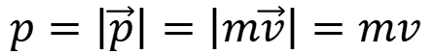
Solution
Describe the kinetic energy of a particle in terms of its mass $m(t)$ and magnitude of its momentum $\left|\vec{p}\left(t\right)\right|=p(t)$.
Kinetic energy of a particle:
$$E_{k}=\frac{1}{2}mv^{2}$$
Velocity of the particle (magnitude of the velocity vector $v\left(t\right)=\left|\vec{v}(t)\right|$)
Mass of the particle ($m(t)$)
Magnitude of momentum of a particle:
$$p=\left|\vec{p}\right|=\left|m\vec{v}\right|=mv$$
Notes:
PARLER LENTEMENT: And the magnitude of the momentum is simply the mass of the particle multiplied by the velocity of this particle, Take care that the magnitude of a vector is always positive, so both sides of the equations are always positive.

Slide 30
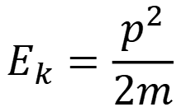
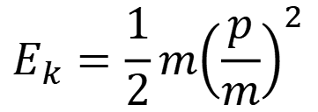
Solution
Describe the kinetic energy of a particle in terms of its mass $m(t)$ and magnitude of its momentum $\left|\vec{p}\left(t\right)\right|=p(t)$.
Kinetic energy of a particle:
$$E_{k}=\frac{1}{2}mv^{2}$$
Velocity of the particle (magnitude of the velocity vector $v\left(t\right)=\left|\vec{v}(t)\right|$)
Mass of the particle ($m(t)$)
Magnitude of momentum of a particle:
$$p=\left|\vec{p}\right|=\left|m\vec{v}\right|=mv$$
$$E_{k}=\frac{1}{2}m{\left(\frac{p}{m}\right)}^{2}$$
$$E_{k}=\frac{p^{2}}{2m}$$
Notes:
PARLER LENTEMENT:By using these equations, we obtain an expression of the kinetic energy. It is the half of the square of the magnitude of the momentum divided by the mass of the particle.

Slide 31
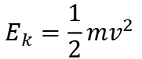
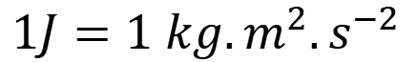
2.Verify your results by checking the units and describe 1 J in terms of units: kg, m, s (reminder: the SI unit for energy is the Joules, symbol: J) .
$$1J=1 kg.m^{2}.s^{−2}$$
Easy to remember from the expression of the kinetic energy
$$E_{k}=\frac{1}{2}mv^{2}$$
Notes:
PARLER LENTEMENT: Now, lets discuss about the units. 1 joules is one kilogram, square meter, per square second, Of course, you could remember it, but there is more simple. If you remember of the expression of the kinetic energy, you will know easily what is one Joule, because the SI unit of the mass is the kilogram, and SI unit of the velocity is the meter per second,

Slide 32
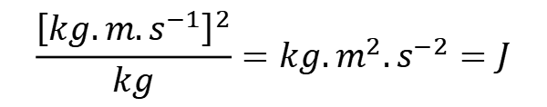
2.Verify your results by checking the units and describe 1 J in terms of units: kg, m, s (reminder: the SI unit for energy is the Joules, symbol: J) .
$$1J=1 kg.m^{2}.s^{−2}$$
Easy to remember from the expression of the kinetic energy
$$E_{k}=\frac{1}{2}mv^{2}$$
SI: Unit of the momentum p: $kg.m.s^{−1}$
$$E_{k}=\frac{p^{2}}{2m}$$
$$\frac{{\left[kg.m.s^{−1}\right]}^{2}}{kg}=kg.m^{2}.s^{−2}=J$$
Everything seems ok !
Notes:
PARLER LENTEMENT: Now let’s chech the units on the previous result, the SI unit of the square of the momentum divided by the mass is 1 Joule, as we should expect for the kinetic energy. So, here everything seems ok with the units.

Slide 33
Checking the units is not an obligation. But it permits often to see mistakes you could have done.
Checking the units cannot permit to see all of the mistakes (for instance, if you forgot the coefficient 2 in the expression of the kinetic energy, you cannot see it by checking the units).
Notes:
PARLER LENTEMENT: When you do such calculations, I suggest you to check the units. It is not an obligation, but you could see mistakes you have done by this way. Of course it depends to the time you have to solve exercises. For instance, in an examination, you could miss this time … Also, Checking the units cannot permit to see all of the mistakes. For instance, in the previous exercise, if you forgot the coefficient 2 in the expression of the kinetic energy, it is not a mistake you will see by checking the units.

Slide 34
Momentum and Kinetic Energy (K.E.)
The K. E is a scalar, momentum is a vector
Notes:
PARLER LENTEMENT: Here is the summary of how kinetic energy and momentum are related together. But first, take care that the kinetic energy is a scalar, but the momentum is vector.

Slide 35
Momentum and Kinetic Energy (K.E.)
The K. E is a scalar, momentum is a vector
Both momentum and K. E. depends to the mass and velocity
Notes:
PARLER LENTEMENT: Both momentum and kinetic energy depend on the mass and the velocity. But for the momentum, it depends on the velocity vector which has same direction than the momentum.

Slide 36
Momentum and Kinetic Energy (K.E.)
The K. E is a scalar, momentum is a vector
Both momentum and K. E. depends to the mass and velocity
If there is no momentum, there is no K. E.
Notes:
PARLER LENTEMENT: If there is no momentum, which means the momentum is zero, which happens if the particle is at rest, the particle has no kinetic energy. Its kinetic energy is zero.

Slide 37
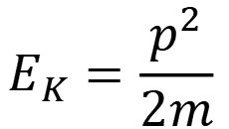
Momentum and Kinetic Energy (K.E.)
The K. E is a scalar, momentum is a vector
Both momentum and K. E. depends to the mass and velocity
If there is no momentum, there is no K. E.
An expression of K. E. is:
$$E_{K}=\frac{p^{2}}{2m}$$
Where p is the magnitude of the momentum $\vec{p}$
Notes:
PARLER LENTEMENT: And finally here is the expression of the kinetic energy in terms of momentum. I should say you that this expression is important to remember, but if you know the expression of the momentum and the expression of the kinetic energy you can find it easily by yourself, as you have done in the exercise.

Slide 38
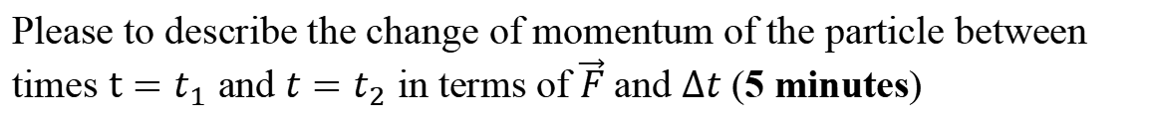

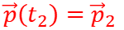
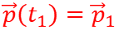
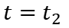
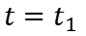
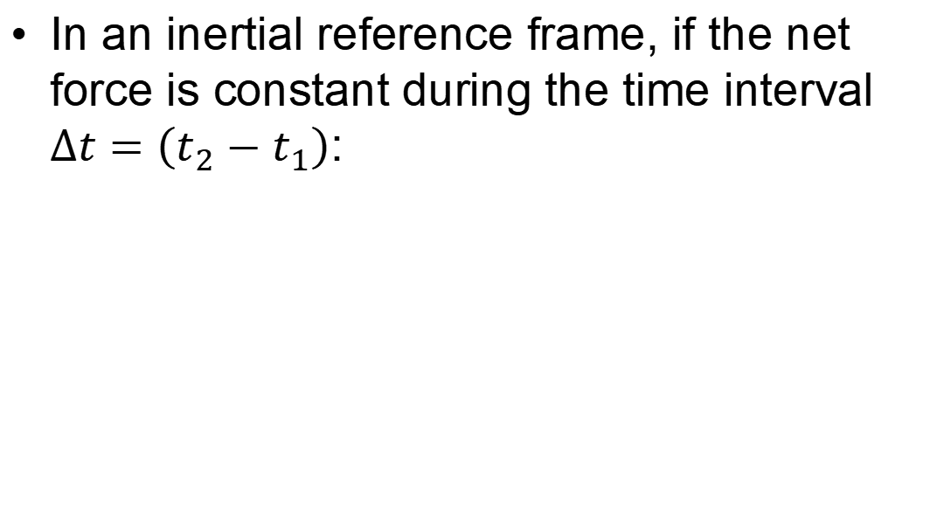
Ex. Momentum change for a constant net force during a time interval
In an inertial reference frame, if the net force is constant during the time interval $∆t=\left(t_{2}−t_{1}\right)$:
$$\vec{F}$$
$$\vec{F}$$
$$t=t_{1}$$
$$t=t_{2}$$
$$\vec{p}\left(t_{1}\right)={\vec{p}}_{1}$$
$$\vec{p}\left(t_{2}\right)={\vec{p}}_{2}$$
Please to describe the change of momentum of the particle between times $t=t_{1}$ and ${t=t}_{2}$ in terms of $\vec{F}$ and $∆t$ (5 minutes)
Notes:
PARLER LENTEMENT: Now lets consider the momentum change of a particle if a constant net force is exerted on it during a certain time interval delta t, We consider an inertial reference frame, thus we can use the Newton’s second law. Here is an example, the particle moves from the position at time t1 to the position at time t2. It has a certain momentum at time t1 and another momentum at time t2, because a net force is exerted on the particle. We want to describe the change of momentum corresponding to the net force exerted on the time interval delta t. Please to describe what is the corresponding change of momentum between times t1 and t2,

Slide 39
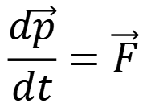
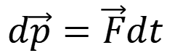
Momentum change for a constant net force during a time interval
$$\vec{F}$$
$$t=t_{1}$$
$$t=t_{2}$$
$$\vec{p}\left(t_{1}\right)={\vec{p}}_{1}$$
$$\vec{p}\left(t_{2}\right)={\vec{p}}_{2}$$
$$\frac{d\vec{p}}{dt}=\vec{F}$$
Newton 2nd law:
$$d\vec{p}=\vec{F}dt$$
Notes:
PARLER LENTEMENT: We just have to apply the Newton’s second law, The time derivative of the momentum is also the net force, so an infinitesimal change of momentum is the net force multiplied by the infinitesimal time interval dt,

Slide 40
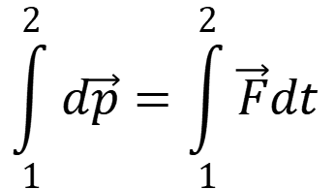
Momentum change for a constant net force during a time interval
$$\vec{F}$$
$$t=t_{1}$$
$$t=t_{2}$$
$$\vec{p}\left(t_{1}\right)={\vec{p}}_{1}$$
$$\vec{p}\left(t_{2}\right)={\vec{p}}_{2}$$
$$\frac{d\vec{p}}{dt}=\vec{F}$$
Newton 2nd law:
$$\int_{1}^{2}{d\vec{p}}=\int_{1}^{2}{\vec{F}dt}$$
$$d\vec{p}=\vec{F}dt$$
Notes:
PARLER LENTEMENT: And we have just to apply the integral in both sides of the equation, 1 means here the initial position of the particle at time t1, 2 means the final position at time t2,

Slide 41
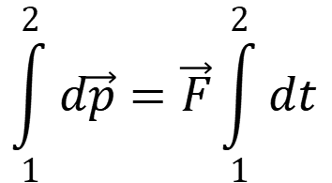
Momentum change for a constant net force during a time interval
$$\vec{F}$$
$$t=t_{1}$$
$$t=t_{2}$$
$$\vec{p}\left(t_{1}\right)={\vec{p}}_{1}$$
$$\vec{p}\left(t_{2}\right)={\vec{p}}_{2}$$
$$\frac{d\vec{p}}{dt}=\vec{F}$$
Newton 2nd law:
$$\int_{1}^{2}{d\vec{p}}=\int_{1}^{2}{\vec{F}dt}$$
$$\int_{1}^{2}{d\vec{p}}=\vec{F}\int_{1}^{2}{dt}$$
$$d\vec{p}=\vec{F}dt$$
(because the net force is constant)
Notes:
PARLER LENTEMENT: But in this exercise, the net force exterted on the particle is constant. We can put it outside the integral,

Slide 42
Momentum change for a constant net force during a time interval
$$\vec{F}$$
$$t=t_{1}$$
$$t=t_{2}$$
$$\vec{p}\left(t_{1}\right)={\vec{p}}_{1}$$
$$\vec{p}\left(t_{2}\right)={\vec{p}}_{2}$$
$$\frac{d\vec{p}}{dt}=\vec{F}$$
Newton 2nd law:
$$\int_{1}^{2}{d\vec{p}}=\int_{1}^{2}{\vec{F}dt}$$
$$\int_{1}^{2}{d\vec{p}}=\vec{F}\int_{1}^{2}{dt}$$
$$d\vec{p}=\vec{F}dt$$
(because the net force is constant)
$$\vec{p}\left(t_{2}\right)−\vec{p}\left(t_{1}\right)=\vec{F}\left(t_{2}−t_{1}\right)=\vec{F}∆t$$
Notes:
PARLER LENTEMENT: Finnally, we obtain that the change of momentum during the constant net force during the time interval is the net force multiplied by the time interval.

Slide 43
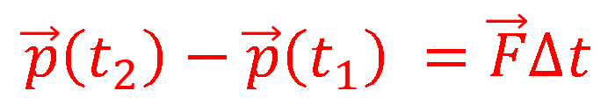
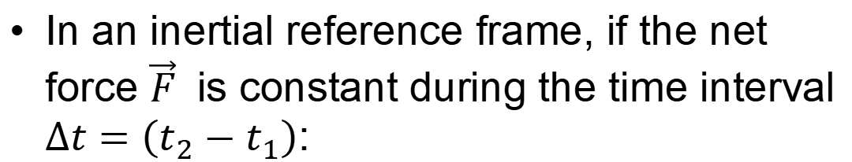
Momentum change for a constant net force during a time interval
In an inertial reference frame, if the net force $\vec{F}$ is constant during the time interval $∆t=\left(t_{2}−t_{1}\right)$:
$$\vec{p}\left(t_{2}\right)−\vec{p}\left(t_{1}\right) =\vec{F}∆t$$
Important result to remember
Notes:
PARLER LENTEMENT: And this is an important result to remember, Of course, if you remember the Newton second law, you will be able to find it by yourself easily.

Slide 44
Rest time (5 minutes)

Slide 45
3. The impulse-momentum theorem
Notes:
PARLER LENTEMENT: The result of the previous exercise will permit us to describe the impulse momentum theorem.

Slide 46
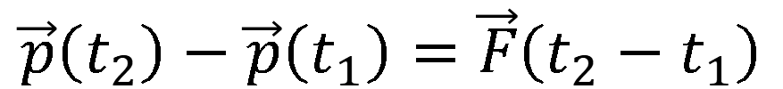
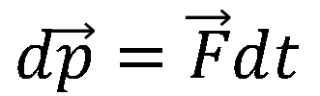
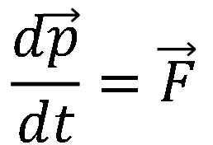
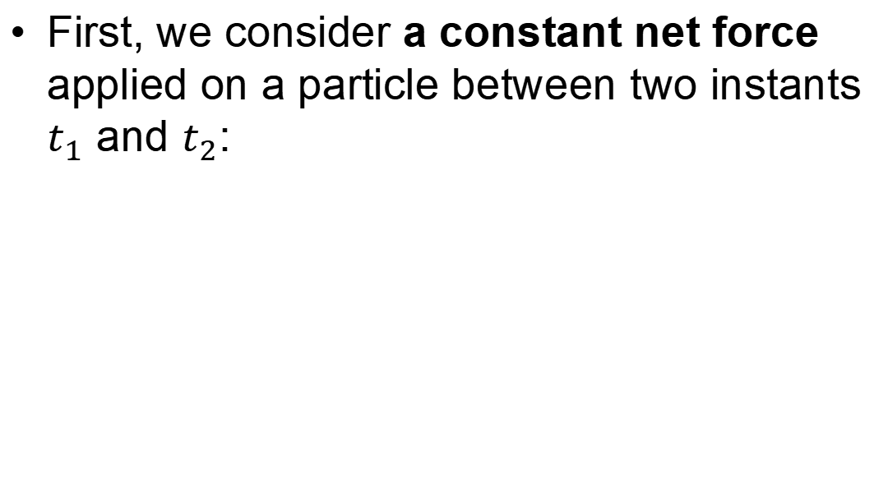
Introduction to the impulse of the net force
First, we consider a constant net force applied on a particle between two instants $t_{1}$ and $t_{2}$:
$$\frac{d\vec{p}}{dt}=\vec{F}$$
$$d\vec{p}=\vec{F}dt$$
By integration, we obtain:
$$\vec{p}\left(t_{2}\right)−\vec{p}\left(t_{1}\right)=\vec{F}\left(t_{2}−t_{1}\right)$$
Notes:
PARLER LENTEMENT: Before to describe what is the impulse of the net force, we have to describe what is the change of momentum if the net force exerted on a particle is constant. It is the result we obtained in the previous exercise.

Slide 47


The impulse of the net force
Now we consider a net force which is not constant between the two instants $t_{1}$ and $t_{2}$:
$$\int_{1}^{2}{d\vec{p}}=\int_{t_{1}}^{t_{2}}{\vec{F}dt}$$
$$d\vec{p}=\vec{F}dt$$
Notes:
PARLER LENTEMENT: Now we consider a net force which is not constant. We can still use the following equations, but we cannot put the net force outside the integral.

Slide 48


The impulse of the net force
Now we consider a net force which is not constant between the two instants $t_{1}$ and $t_{2}$:
$$\int_{1}^{2}{d\vec{p}}=\int_{t_{1}}^{t_{2}}{\vec{F}dt}$$
$$d\vec{p}=\vec{F}dt$$
$$\vec{p}\left(t_{2}\right)−\vec{p}\left(t_{1}\right)=\int_{t_{1}}^{t_{2}}{\vec{F}dt}$$
$$\vec{J}=$$
$\vec{J}$is the impulse of the net force applied on the particle
Notes:
PARLER LENTEMENT: The change of momentum is described by the vector J. And impulse of the net force is it is the integral of the net force over the infinitesimal time interval dt between the initial time t1 and the final time interval t2,

Slide 49


The impulse-momentum theorem
The change in momentum of a particle:
$$\vec{J}=\vec{p}\left(t_{2}\right)−\vec{p}\left(t_{1}\right)=\vec{p_{2}}−\vec{p_{1}}$$
Impulse-momentum theorem: The change in momentum of a particle during a time interval is equal to the impulse of the net force applied on the particle.
$$\vec{J}=\int_{t_{1}}^{t_{2}}{\vec{F}dt}$$
Where the impulse of the net force is
Notes:
PARLER LENTEMENT: The previous equation describes also what is the impulse-momentum theorem: The change in momentum of a particle during a time interval is equal to the impulse of the net force applied on the particle. So, the vector J describe the change of momentum of the particle and describe also the impulse of the net force exerted on the particle,

Slide 50


The average net force during a time interval
The impulse of the net force :
$$\vec{J}=\int_{t_{1}}^{t_{2}}{\vec{F}dt}$$
The average net force is defined as the constant net force which gives the same impulse during the same time interval:
$$\vec{J}={\vec{F}}_{av}\left(t_{2}−t_{1}\right)$$
Notes:
PARLER LENTEMENT: From the previous equation, we can describe an average net force exerted on the particle between two times, The average net force is defined as the constant net force which gives the same impulse during the same time interval. We have seen that the change of momentum corresponding to a constant net force is the constant net force multiplied by the time interval,

Slide 51



The average net force during a time interval
The impulse of the net force :
$$\vec{J}=\int_{t_{1}}^{t_{2}}{\vec{F}dt}$$
The average net force is defined as the constant net force which gives the same impulse during the same time interval:
$$\vec{J}={\vec{F}}_{av}\left(t_{2}−t_{1}\right)$$
$${\vec{F}}_{av}=\frac{1}{t_{2}−t_{1}}\int_{t_{1}}^{t_{2}}{\vec{F}dt}$$
Notes:
PARLER LENTEMENT: We obtain the expression of the average net force. It the impulse of the net force divided by the time interval t_2 minus t_1. This result is not a big surprise, if we are used to integral calculations.

Slide 52



The conservation of the momentum: Introduction
First, we consider an isolated system of two particles A and B, where is no external forces exerted on the system, only internal force ${\vec{F}}_{B/A}$ exerted by B on A and the internal force ${\vec{F}}_{A/B}$ exerted by A on B
A
B
$${\vec{F}}_{B/A}$$
$${\vec{F}}_{A/B}$$
Notes:
PARLER LENTEMENT: Before to describe elastic and inelastic collisions, we will have to describe the conservation of the momentum, an important property which permit to describe collisions between bodies. We consider an isolated system of two particles A and B, Isolated means there is no external forces exerted to this system. Thus, the only forces to consider are the forces exerted by the particle B on A and by the particle A on B,

Slide 53


The conservation of the momentum: Introduction
First, we consider an isolated system of two particles A and B, where is no external forces exerted on the system, only internal force ${\vec{F}}_{B/A}$ exerted by B on A and the internal force ${\vec{F}}_{A/B}$ exerted by A on B
A
B
$${\vec{F}}_{B/A}$$
$${\vec{F}}_{A/B}$$
${\vec{F}}_{B/A}$=$\frac{d{\vec{p}}_{A}}{dt}$
The net force on the particle A is:
${\vec{F}}_{A/B}$=$\frac{d{\vec{p}}_{B}}{dt}$
The net force on the particle B is:
Notes:
PARLER LENTEMENT: The net force exerted on the particle A is also the force exerted by the particle B on the particle A because there is no other forces acting on particle A. This net force is also the change rate of the momentum of the particle A. Also the net force exerted on the particle B is the force exerted by the particle A and it is also the change rate of momentum of the particle B. In this example, the both particles are not in contact to each other, but this doesn’t means there is no force between them, For instance there could be gravitational forces exerted between them. There could be other forces acting at distance we will see later during the year.

Slide 54

The conservation of the momentum: Introduction
First, we consider an isolated system of two particles A and B, where is no external forces exerted on the system, only internal force ${\vec{F}}_{B/A}$ exerted by B on A and the internal force ${\vec{F}}_{A/B}$ exerted by A on B
A
B
$${\vec{F}}_{B/A}$$
$${\vec{F}}_{A/B}$$
${\vec{F}}_{B/A}$=$\frac{d{\vec{p}}_{A}}{dt}$
The net force on the particle A is:
${\vec{F}}_{A/B}$=$\frac{d{\vec{p}}_{B}}{dt}$
The net force on the particle B is:
$${\vec{F}}_{B/A}+{\vec{F}}_{A/B}=\vec{0}$$
And the sum of these internal forces is :
(because of the Newton’s 3rd law)
Notes:
PARLER LENTEMENT:And the sum of these internal forces, the force exerted between particles inside the system we consider is zero, because of the Newton 3rd law: the force exerted by the particle B on particle A is equal and opposite to the force exerted by particle A on particle B.

Slide 55

The principle of conservation of the momentum: Introduction
$${\vec{F}}_{B/A}+{\vec{F}}_{A/B}=\vec{0}$$
And the sum of these internal forces is :
(because of the Newton’s 3rd law)
$$\frac{{d\vec{p}}_{A}}{dt}+\frac{{d\vec{p}}_{B}}{dt}=\frac{{d(\vec{p}}_{A}+{\vec{p}}_{B})}{dt}=\vec{0}$$
We obtain:
Notes:
PARLER LENTEMENT: By using the equations of the previous slide, we obtain that the change rate of momentum of particle A + the change rate of momentum of particle B is equals 0,

Slide 56


The principle of conservation of the momentum: Introduction
$${\vec{F}}_{B/A}+{\vec{F}}_{A/B}=\vec{0}$$
And the sum of these internal forces is :
(because of the Newton’s 3rd law)
$$\frac{{d\vec{p}}_{A}}{dt}+\frac{{d\vec{p}}_{B}}{dt}=\frac{{d(\vec{p}}_{A}+{\vec{p}}_{B})}{dt}=\vec{0}$$
We obtain:
$$\frac{d\vec{P}}{dt}=\vec{0}$$
Using the total momentum
$$\vec{P}={\vec{p}}_{A}+{\vec{p}}_{B}$$
, we obtain
Notes:
PARLER LENTEMENT: Thus, if we describe the total momentum of the system which include both particles as the sum of the momentum of each particle, we obtain that the change rate of the total momentum equals zero. We have demonstrated here the principle of conservation of the momentum.

Slide 57


The principle of conservation of the momentum
If there is no external forces on a system or if the sum of external forces is equal to $\vec{0}$ , the total momentum of the system is constant. This is the principle of conservation of momentum
Total momentum of a system of N particles:
$$\vec{P}=\sum_{i=1}^{N}{{\vec{p}}_{i}}=\sum_{i=1}^{N}{m_{i}{\vec{v}}_{i}}=m_{1}{\vec{v}}_{1}+m_{2}{\vec{v}}_{2}+…+m_{N}{\vec{v}}_{N}$$
Notes:
PARLER LENTEMENT: Here is the sentence describe the principle of momentum of a system. If there is no external forces exerted on a system or if the sum of external forces is zero, the total momentum of the system stay constant. We say the total momentum is conserved. In our demonstration, there was two particles in the system, but could demonstrate it for any number of particles N in the system and the total momentum is simply the sum of all the momentum of the N particles in the system. If you wish, you can try to demonstrate the principle of conservation of momentum for any number of particles in the system, it is not a problem very difficult to do. This principle of conservation of momentum will permit us to describe collisions.

Slide 58
4. About elastic and inelastic collisions
Notes:
PARLER LENTEMENT: And the last part of this lesson is about the descriptions of collisions which can be elastic or inelastic,

Slide 59
Elastic collisions
All collisions where external forces are neglected have conservation of total momentum of the system (of the bodies in collision ).
Notes:
PARLER LENTEMENT: For all of this section we will consider external forces on a system of bodies in collusion are neglected, which means there conservation of the total momentum of the system,

Slide 60
Elastic collisions
All collisions where external forces are neglected have conservation of total momentum of the system (of the bodies in collision ).
Elastic collisions: An ideal model where the total momentum and kinetic energy of a system is conserved (there is always kinetic energy loss by heat, there could be permanent deformations …)
Notes:
PARLER LENTEMENT: In the collisions we will describe, there will two possible kinds, For the case of the elastic collision, not only the momentum of the system is conserved but also the kinetic energy. Take care that this model is an ideal model, During collisions, the kinetic energy is not conserved, a part of kinetic energy could be loss by heat for instance. Or if you consider collisions between vehicles, the collision results in deformations of the vehicles.

Slide 61



Elastic collisions
Example of elastic collision:
$$m_{1}$$
$$m_{2}$$
before collision
after collision
$${\left({\vec{p}}_{1}+{\vec{p}}_{2}\right)}_{before}={\left({\vec{p}}_{1}+{\vec{p}}_{2}\right)}_{after}$$
Conservation of momentum (system of two bodies)
Notes:
PARLER LENTEMENT: So, here is an example of elastic collision between two balls here, We consider three kinds of times: before the collision, during the collision when the balls are in contact and after the collision. The first ball has mass constant m1 and velocity v1. The second ball has mass constant m2 and velocity v2. The momentums of the ball are such as there is conservation of the total momentum of the system which include these two balls, We obtain an expression between the momentums of the balls before the collision and after the collision, Int this expression, you can write the mass and the velocities instead of the momentum.

Slide 62
Elastic collisions
Example of elastic collision:
$$m_{1}$$
$$m_{2}$$
before collision
after collision
$${\left({\vec{p}}_{1}+{\vec{p}}_{2}\right)}_{before}={\left({\vec{p}}_{1}+{\vec{p}}_{2}\right)}_{after}$$
Conservation of momentum (system of two bodies)
$${\left(E_{k,1}+E_{k,2}\right)}_{before}={\left(E_{k,1}+E_{k,2}\right)}_{after}$$
Conservation of kinetic energy. (system of two bodies)
Notes:
PARLER LENTEMENT: And in the case of elastic collisions, there is also conservation of the kinetic energy of the system of the two balls here. The kinetic energy of a system is simply the sum of the kinetic energy of the particles in the system. The kinetic energy of the system before the collision is equal to the kinetic energy of the system after the collision. From these both equations, you can describe what are the velocity vectors of the both bodies after the collision if you know what are their velocity vectors before the collision.

Slide 63

Inelastic collisions
Inelastic collisions: The total kinetic energy of the system is not conserved.
Completely inelastic collisions: the bodies stick together
An example of completely inelastic collision
Notes:
PARLER LENTEMENT: Now, let’s describe other kinds of collisions. We still consider there is no external forces on the system of two bodies or the sum of external forces is zero, which means the momentum of the system is conserved, But unlike previously, the kinetic energy of the system is not conserved, these collisions are named inelastic collisions. A particular case of inelastic collisions is the completely inelastic collisions. In that case, the bodies in collision stick together after the collision, which means they have the same velocity vector. You can see an example of completely inelastic collision here.

Slide 64




Ex. A completely inelastic collision (5 minutes)
$$\vec{v_{A1}}$$
$${\vec{v}}_{2}=?$$
$$\vec{v_{B1}}=\vec{0}$$
$$x$$
A body of mass $m_{A}$ and velocity vector $\vec{v_{A1}}$ in the $+x$-direction has a completely inelastic collision with a body of mass $m_{B}$ at rest ($\vec{v_{B1}}=\vec{0}$). After a completely inelastic collision both bodies have velocity $\vec{v_{2}}$.
Describe the conservation of momentum of the system body A+ body B
Gives the expression of x-component $v_{2,x}$of ${\vec{v}}_{2}$ in respect to $m_{A}, m_{B}, v_{A1,x}$
Describe the ratio between the kinetic energy of the system (of two bodies A and B) after and before the collision ${E_{K,2}}/{E_{K,1}}$ in terms of $m_{A}, m_{B}$
Notes:
PARLER LENTEMENT: And this is what I will ask you to describe. Before the collision, the grandmother has a velocity vector VA1 directed toward the right. Before the collision, the boy is at rest. After the collision both bodies have the same velocity vector v2 because the collision is completely inelastic. First, please to describe the conservation of both bodies in this situation. Then, you can see the x-axis is the horizontal axis. Please to describe the x-component of their velocity vector after the collision, If you do that, it’s great. I don’t think you can finish the last question in 5 minutes which is to describe the ratio of the kinetic energy of the system before and after the collision. This ratio cannot be one, because here the collision is not an elastic collision.

Slide 65
Ex. A completely inelastic collision (5 minutes)
$$\vec{v_{A1}}$$
$${\vec{v}}_{2}=?$$
$$\vec{v_{B1}}=\vec{0}$$
$$x$$
Describe the conservation of momentum of the system body A+ body B
$${\left({\vec{p}}_{A}+{\vec{p}}_{B}\right)}_{before}={\left({\vec{p}}_{A}+{\vec{p}}_{B}\right)}_{after}$$
Notes:
PARLER LENTEMENT: First, we know that the total momentum of the system before the collision is the same after the collision.

Slide 66


Ex. A completely inelastic collision (5 minutes)
$$\vec{v_{A1}}$$
$${\vec{v}}_{2}=?$$
$$\vec{v_{B1}}=\vec{0}$$
$$x$$
Describe the conservation of momentum of the system body A+ body B
$${\left({\vec{p}}_{A}+{\vec{p}}_{B}\right)}_{before}={\left({\vec{p}}_{A}+{\vec{p}}_{B}\right)}_{after}$$
$$m_{A}\vec{v_{A1}}=m_{A}\vec{v_{2}}+m_{B}\vec{v_{2}}$$
(the momentum of body B at rest is $\vec{0}$)
Notes:
PARLER LENTEMENT: We can put in the equation the mass of the bodies and their velocity, Here the velocity of the body B before the collusion don’t appears because it is zero, so I have omitted it.

Slide 67
Ex. A completely inelastic collision (5 minutes)
$$\vec{v_{A1}}$$
$${\vec{v}}_{2}=?$$
$$\vec{v_{B1}}=\vec{0}$$
$$x$$
b)Gives the expression of x-component $v_{2,x}$of ${\vec{v}}_{2}$ in respect to $m_{A}, m_{B}, v_{A1,x}$
$$m_{A}\vec{v_{A1}}=m_{A}\vec{v_{2}}+m_{B}\vec{v_{2}}=\left(m_{A}+m_{B}\right)\vec{v_{2}}$$
Notes:
PARLER LENTEMENT: Now, let’s describe the x-component of their velocity vector after the collision. You can see here that the mass of body A multiplied by its velocity vector before the collision is equal to the sum of the mass of both bodies multiplied by their velocity after the collision,

Slide 68


Ex. A completely inelastic collision (5 minutes)
$$\vec{v_{A1}}$$
$${\vec{v}}_{2}=?$$
$$\vec{v_{B1}}=\vec{0}$$
$$x$$
b)Gives the expression of x-component $v_{2,x}$of ${\vec{v}}_{2}$ in respect to $m_{A}, m_{B}, v_{A1,x}$
$$m_{A}\vec{v_{A1}}=m_{A}\vec{v_{2}}+m_{B}\vec{v_{2}}=\left(m_{A}+m_{B}\right)\vec{v_{2}}$$
$$\vec{v_{2}}=\frac{m_{A}}{m_{A}+m_{B}}\vec{v_{A1}}$$
$$v_{2,x}=\frac{m_{A}}{m_{A}+m_{B}}v_{A1,x}$$
Notes:
PARLER LENTEMENT: We obtain an expression of their velocity vector after the collision, which permits to describe its x-component. Take care to not confuse a velocity vector, which is a vector and its x-component which is a scalar.

Slide 69



Ex. A completely inelastic collision (5 minutes)
$$\vec{v_{A1}}$$
$${\vec{v}}_{2}=?$$
$$\vec{v_{B1}}=\vec{0}$$
(c) Describe the ratio between the kinetic energy of the system (body A + body B)after and before the collision ${E_{K,2}}/{E_{K,1}}$
$$x$$
$$E_{K,2}=\frac{1}{2}m_{A}v_{2}^{2}+\frac{1}{2}m_{B}v_{2}^{2}=\frac{1}{2}\left(m_{A}+m_{B}\right)v_{2}^{2}$$
After the collision
$$E_{K,1}=\frac{1}{2}m_{A}v_{A1}^{2}$$
Before the collision (because body B is at rest before the collision)
Notes:
PARLER LENTEMENT: Now lets describe the ratio between the kinetic energy of the system A plus B after the collision and before the collision, After the collision, the kinetic energy of the system is the sum of the kinetic energy of both bodies, We obtain that it is the half of the sum of their mass multiplied by the square of their velocity. Before the collision, the kinetic energy of the system is the kinetic energy of the body A because the body B is at rest.

Slide 70



Ex. A completely inelastic collision (5 minutes)
$$\vec{v_{A1}}$$
$${\vec{v}}_{2}=?$$
$$\vec{v_{B1}}=\vec{0}$$
(c) Describe the ratio between the kinetic energy of the system after and before the collision ${E_{K,2}}/{E_{K,1}}$
$$x$$
$$E_{K,2}=\frac{1}{2}m_{A}v_{2}^{2}+\frac{1}{2}m_{B}v_{2}^{2}=\frac{1}{2}\left(m_{A}+m_{B}\right)v_{2}^{2}$$
$$E_{K,1}=\frac{1}{2}m_{A}v_{A1}^{2}$$
$$v_{2}=\frac{m_{A}}{m_{A}+m_{B}}v_{A1}$$
$$v_{2}^{2}={\left(\frac{m_{A}}{m_{A}+m_{B}}\right)}^{2}v_{A1}^{2}$$
Notes:
PARLER LENTEMENT: From the previous question, we can describe their velocity after the collision. We put it at the square.

Slide 71

Ex. A completely inelastic collision (5 minutes)
$$\vec{v_{A1}}$$
$${\vec{v}}_{2}=?$$
$$\vec{v_{B1}}=\vec{0}$$
(c) Describe the ratio between the kinetic energy of the system after and before the collision ${E_{K,2}}/{E_{K,1}}$
$$x$$
$$E_{K,2}=\frac{1}{2}m_{A}v_{2}^{2}+\frac{1}{2}m_{B}v_{2}^{2}=\frac{1}{2}\left(m_{A}+m_{B}\right)v_{2}^{2}$$
$$E_{K,1}=\frac{1}{2}m_{A}v_{A1}^{2}$$
$$v_{2}=\frac{m_{A}}{m_{A}+m_{B}}v_{A1}$$
$$v_{2}^{2}={\left(\frac{m_{A}}{m_{A}+m_{B}}\right)}^{2}v_{A1}^{2}$$
$$E_{K,2}=\frac{1}{2}\left(m_{A}+m_{B}\right){\left(\frac{m_{A}}{m_{A}+m_{B}}\right)}^{2}v_{A1}^{2}$$
Notes:
PARLER LENTEMENT: And we obtain this expression for the kinetic energy of the system after the collision.

Slide 72

Ex. A completely inelastic collision (5 minutes)
$$\vec{v_{A1}}$$
$${\vec{v}}_{2}=?$$
$$\vec{v_{B1}}=\vec{0}$$
(c) Describe the ratio between the kinetic energy of the system after and before the collision ${E_{K,2}}/{E_{K,1}}$
$$x$$
$$E_{K,2}=\frac{1}{2}m_{A}v_{2}^{2}+\frac{1}{2}m_{B}v_{2}^{2}=\frac{1}{2}\left(m_{A}+m_{B}\right)v_{2}^{2}$$
$$E_{K,1}=\frac{1}{2}m_{A}v_{A1}^{2}$$
$$v_{2}=\frac{m_{A}}{m_{A}+m_{B}}v_{A1}$$
$$v_{2}^{2}={\left(\frac{m_{A}}{m_{A}+m_{B}}\right)}^{2}v_{A1}^{2}$$
$$E_{K,2}=\frac{1}{2}\left(m_{A}+m_{B}\right){\left(\frac{m_{A}}{m_{A}+m_{B}}\right)}^{2}v_{A1}^{2}$$
$$\frac{E_{K,2}}{E_{K,1}}=\frac{m_{A}}{m_{A}+m_{B}}$$
Notes:
PARLER LENTEMENT: Which permit to describe the ratio between the kinetic energy of the system after the collision and before. You can see here that this ratio is not equals 1, the collision was not an elastic collision, the kinetic energy of the system changed and is smaller after the collision than before the collision.

Slide 73
Rest time (5 minutes)

Slide 74
5. The center of mass
Notes:
PARLER LENTEMENT: We have seen equations which permit to describe the motion of a particle, such as the Newton’s second law. From this lecture, we will describe the motion of any body, not only a particle. For that, we have to describe the center of mass of a body, also named the center of gravity.

Slide 75

The center of mass: introduction
We have seen the total momentum of a system of N particles:
$$\vec{P}=\sum_{i=1}^{N}{{\vec{p}}_{i}}=\sum_{i=1}^{N}{m_{i}{\vec{v}}_{i}}=m_{1}{\vec{v}}_{1}+m_{2}{\vec{v}}_{2}+…+m_{N}{\vec{v}}_{N}$$
Notes:
PARLER LENTEMENT: We have described previously the total momentum of a system of N particles. It is the sum of all momentum of the particles in the system. Any body can be seen of as a system of N particles.

Slide 76

The center of mass: introduction
We have seen the total momentum of a system of N particles:
$$\vec{P}=\sum_{i=1}^{N}{{\vec{p}}_{i}}=\sum_{i=1}^{N}{m_{i}{\vec{v}}_{i}}=m_{1}{\vec{v}}_{1}+m_{2}{\vec{v}}_{2}+…+m_{N}{\vec{v}}_{N}$$
This expression can be in the form:
$$M\vec{V}=m_{1}{\vec{v}}_{1}+m_{2}{\vec{v}}_{2}+…+m_{N}{\vec{v}}_{N}$$
Notes:
PARLER LENTEMENT: We can also expression the total momentum as follows, it is the product between a certain mass M and velocity vector V.

Slide 77

The center of mass: introduction
We have seen the total momentum of a system of N particles:
$$\vec{P}=\sum_{i=1}^{N}{{\vec{p}}_{i}}=\sum_{i=1}^{N}{m_{i}{\vec{v}}_{i}}=m_{1}{\vec{v}}_{1}+m_{2}{\vec{v}}_{2}+…+m_{N}{\vec{v}}_{N}$$
This expression can be in the form:
$$M\vec{V}=m_{1}{\vec{v}}_{1}+m_{2}{\vec{v}}_{2}+…+m_{N}{\vec{v}}_{N}$$
where
$$M=m_{1}+m_{2}+…+m_{N}$$
Notes:
PARLER LENTEMENT: Where M is the total mass of the system, which is the sum of the mass of all the particles in the system.

Slide 78

The center of mass: introduction
We have seen the total momentum of a system of N particles:
$$\vec{P}=\sum_{i=1}^{N}{{\vec{p}}_{i}}=\sum_{i=1}^{N}{m_{i}{\vec{v}}_{i}}=m_{1}{\vec{v}}_{1}+m_{2}{\vec{v}}_{2}+…+m_{N}{\vec{v}}_{N}$$
This expression can be in the form:
$$M\vec{V}=m_{1}{\vec{v}}_{1}+m_{2}{\vec{v}}_{2}+…+m_{N}{\vec{v}}_{N}$$
where
$$M=m_{1}+m_{2}+…+m_{N}$$
$$\vec{V}=\frac{m_{1}{\vec{v}}_{1}+m_{2}{\vec{v}}_{2}+…+m_{N}{\vec{v}}_{N}}{m_{1}+m_{2}+…+m_{N} }$$
Notes:
PARLER LENTEMENT: We obtain an expression of the velocity V. You can see with this formula that the velocity V is an average of the velocity vector of particles weighted by their mass.

Slide 79

The center of mass: introduction
We have seen the total momentum of a system of N particles:
$$\vec{P}=\sum_{i=1}^{N}{{\vec{p}}_{i}}=\sum_{i=1}^{N}{m_{i}{\vec{v}}_{i}}=m_{1}{\vec{v}}_{1}+m_{2}{\vec{v}}_{2}+…+m_{N}{\vec{v}}_{N}$$
This expression can be in the form:
$$M\vec{V}=m_{1}{\vec{v}}_{1}+m_{2}{\vec{v}}_{2}+…+m_{N}{\vec{v}}_{N}$$
where
$$M=m_{1}+m_{2}+…+m_{N}$$
$$\vec{V}=\frac{m_{1}{\vec{v}}_{1}+m_{2}{\vec{v}}_{2}+…+m_{N}{\vec{v}}_{N}}{m_{1}+m_{2}+…+m_{N} }$$
$\vec{V}$ describes the velocity of the center of mass of the system.
$$\vec{V}=\frac{d{\vec{r}}_{cm}}{dt}$$
Notes:
PARLER LENTEMENT: This velocity vector V describes the velocity of the center of mass of the system. As for the velocity vector of a particle, the velocity vector V is the time derivative of the position of the center of mass of the particle. To study the motion of any body is like to center the motion of a particle which the position is the position of the center of mass, the mass is the totak mass of the body and the velocity vector is V. “cm “ means center of mass.

Slide 80

The center of mass: introduction
We have seen the total momentum of a system of N particles:
$$\vec{P}=\sum_{i=1}^{N}{{\vec{p}}_{i}}=\sum_{i=1}^{N}{m_{i}{\vec{v}}_{i}}=m_{1}{\vec{v}}_{1}+m_{2}{\vec{v}}_{2}+…+m_{N}{\vec{v}}_{N}$$
This expression can be in the form:
$$M\vec{V}=m_{1}{\vec{v}}_{1}+m_{2}{\vec{v}}_{2}+…+m_{N}{\vec{v}}_{N}$$
where
$$M=m_{1}+m_{2}+…+m_{N}$$
$$\vec{V}=\frac{m_{1}{\vec{v}}_{1}+m_{2}{\vec{v}}_{2}+…+m_{N}{\vec{v}}_{N}}{m_{1}+m_{2}+…+m_{N} }$$
$\vec{V}$ describes the velocity of the center of mass of the system.
$$\vec{V}=\frac{d{\vec{r}}_{cm}}{dt}$$
where
${\vec{r}}_{cm}$=$\frac{m_{1}{\vec{r}}_{1}+m_{2}{\vec{r}}_{2}+…+m_{N}{\vec{r}}_{N}}{m_{1}+m_{2}+…+m_{N} }$
${\vec{r}}_{cm}$ describes the position of the center of mass (${\vec{r}}_{1}, {\vec{r}}_{2}$, … are the position vectors of the particles of the system)
Notes:
PARLER LENTEMENT: The position of the center of mass is maybe something you have seen in highschool, and is obtained by the previous equation. It is the average position vectors of the particles weighted with their mass. This is the reason why we call it “center of mass”.

Slide 81


Center of mass of a system of N particles
${\vec{r}}_{cm}$=$\frac{m_{1}{\vec{r}}_{1}+m_{2}{\vec{r}}_{2}+…+m_{N}{\vec{r}}_{N}}{m_{1}+m_{2}+…+m_{N} }$
$${\vec{r}}_{cm}$$
Notes:
PARLER LENTEMENT: At the figure at the right, you can see an example of center of mass of a system with only two particles of mass m_1 and m_2. Take care that as in the figure, the center of mass could be not at the middle of these two particles. Its position depends to the mass of each particle in the system.

Slide 82

Center of mass of a system of N particles
${\vec{r}}_{cm}$=$\frac{m_{1}{\vec{r}}_{1}+m_{2}{\vec{r}}_{2}+…+m_{N}{\vec{r}}_{N}}{m_{1}+m_{2}+…+m_{N} }$
In 3D Cartesian coordinates, the coordinates of the center of mass are:
$x_{cm}$=$\frac{m_{1}x_{1}+m_{2}x_{2}+…+m_{N}x_{N}}{m_{1}+m_{2}+…+m_{N} }$
$${\vec{r}}_{cm}$$
Notes:
PARLER LENTEMENT: We can describe the position of the center of mass by its position vector. Or, we can describe its position from the Cartesian components of its potion vector. Here the x-coordinate of the center of mass described from the x-coordinate of the particles in the system.

Slide 83


Center of mass of a system of N particles
${\vec{r}}_{cm}$=$\frac{m_{1}{\vec{r}}_{1}+m_{2}{\vec{r}}_{2}+…+m_{N}{\vec{r}}_{N}}{m_{1}+m_{2}+…+m_{N} }$
In 3D Cartesian coordinates, the coordinates of the center of mass are:
$x_{cm}$=$\frac{m_{1}x_{1}+m_{2}x_{2}+…+m_{N}x_{N}}{m_{1}+m_{2}+…+m_{N} }$
$y_{cm}$=$\frac{m_{1}y_{1}+m_{2}y_{2}+…+m_{N}y_{N}}{m_{1}+m_{2}+…+m_{N} }$
$${\vec{r}}_{cm}$$
$${\vec{r}}_{cm}$$
$z_{cm}$=$\frac{m_{1}z_{1}+m_{2}z_{2}+…+m_{N}z_{N}}{m_{1}+m_{2}+…+m_{N} }$
Notes:
PARLER LENTEMENT: The y-coordinate and z-coordinate of the center of mass are described using the same way. So, if you the position vectors of the particles in the system, you can describe easily the position of the center of mass,

Slide 84

Interest of the center of mass
Interest to follow the motion of center of mass: The overall motion could be complicated but the center of mass follows a motion governed by the Newton’s 2nd law.
Translational and rotational motion (we will see it later) can be described separately.
Notes:
PARLER LENTEMENT: Here is one big interest of study the motion of the center of mass. The motion of a body could be quite complicated, rotational and translational as described in the figure. But the motion of the center of mass of the body is simply governed by the Newton’s second law. In the figure, it is a parabolic motion dure to the gravity. So, even if we don’t know how to describe the rotational motion of this body, we know how to describe its translational motion, because we know how to describe the motion of its center of mass. About the laws governing the rotational motion of bodies, they are not discussed in this lesson, but we will see them laler.

Slide 85

Newton’s 2nd law applied to any body or system of particles
${M\vec{a}}_{cm}$=$\sum{{\vec{F}}_{ext}}$
Mass of the body (considering the mass M is constant)
External forces exerted on the body or the particles in the system
Center of mass
Notes:
PARLER LENTEMENT: Thus, here is the Newton’s second law to describe the motion of the center of mass of a body or a system of particles of total mass M. The mass M of the body multipled by the acceleration of its center of mass is equal to the sum of all external forces exerted is constant. Take care that this Newton’s second law is considering the mass of the body don’t change with time, and if the mass M change with time, you have to use the Newton second law we have seen at the beginning of this lesson. As you certainly understand, the sum of all the external forces is also to what we have named the net force on a particle, but here applied to any kind of body.

Slide 86
Newton’s 2nd law applied to any body or system of particles
${M\vec{a}}_{cm}$=$\sum{{\vec{F}}_{ext}}$
Mass of the body (considering the mass M is constant)
External forces exerted on the body or the particles in the system
Center of mass
There could be internal forces exerted in the body considered, but they cancel to each other because of the Newton’s third law.
Notes:
PARLER LENTEMENT: Why it is necessary to say “external forces” ? This is because there could be internal forces in a system. For instance, if we consider a system of two particles which has together a collision, they exert to each other a force, we have described by the normal force. We could put in this equations the sum of external forces + the sum of internal forces, but all the internal forces in a system cancel to each other because of the Newton’s third law, thus the sum of all internal forces is zero.

Slide 87
Center of mass of any body:
For a collection of N particles:
${\vec{r}}_{cm}$=$\frac{m_{1}{\vec{r}}_{1}+m_{2}{\vec{r}}_{2}+…+m_{N}{\vec{r}}_{N}}{m_{1}+m_{2}+…+m_{N} }$
For any body:
Notes:
PARLER LENTEMENT: A body is not strictly a collection of particles, even if this is a model often interesting to use to study the mechanical properties of the body. So, this equation which describe the center of mass of a system of particles have to be modified in a form we can describe the position of the center of mass of any body.

Slide 88

Center of mass of any body:
For a collection of N particles:
${\vec{r}}_{cm}$=$\frac{m_{1}{\vec{r}}_{1}+m_{2}{\vec{r}}_{2}+…+m_{N}{\vec{r}}_{N}}{m_{1}+m_{2}+…+m_{N} }$
$${\vec{r}}_{cm}=\frac{\int{\vec{r}dm}}{M}$$
For any body:
Notes:
PARLER LENTEMENT: So for any body, the description of mass is almost the same that the description of center of mass for a system of particle, but using an integral form. The center of mass is the integral of the body of the position vector multiplied by the infinitesimal mass dm, and we divide this integral by the mass M of the body. D

Slide 89






Center of mass of any body:
For a collection of N particles:
${\vec{r}}_{cm}$=$\frac{m_{1}{\vec{r}}_{1}+m_{2}{\vec{r}}_{2}+…+m_{N}{\vec{r}}_{N}}{m_{1}+m_{2}+…+m_{N} }$
$${\vec{r}}_{cm}=\frac{\int{\vec{r}dm}}{M}=\frac{\int{\vec{r}ρ(\vec{r})dV}}{M}$$
For any body:
where d$m=ρ(\vec{r})dV$ is an infinitesimal mass, $ρ(\vec{r})$ is the local mass density of the body, $dV$ is an infinitesimal volume in the body, and
$$M=\int{dm}=\int{ρ(\vec{r})dV}$$
is the total mass of the body
$$y$$
$${\vec{r}}_{cm}$$
$$+C_{m}$$
$$dm=ρ(\vec{r})dV$$
$$O$$
$$\vec{r}$$
$$x$$
$$z$$
body
Notes:
PARLER LENTEMENT: dm is an infinitesimal mass in the body. It is the product between the local mass density at a certain position vector of the body and the infinitesimal volume. Usually, we will consider the local mass density is uniform in the body, which means is the same in all the body and you can put it outside the integral in that case. But it is also possible that the local mass density is not uniform and in that case, the position of the center of mass will be more difficult to describe. The total mass is also described by an integral. It is the integral sum of all the infinitesimal masses dm in the body. In the figure, you can see an example of a body and its center of mass. To describe the center of mass of the body we have to know its shape and its local mass density. About the infinitesimal volume dV, we choose it usually depending to the shape of the body we have to consider.

Slide 90
Center of mass of any body:
For a collection of N particles:
${\vec{r}}_{cm}$=$\frac{m_{1}{\vec{r}}_{1}+m_{2}{\vec{r}}_{2}+…+m_{N}{\vec{r}}_{N}}{m_{1}+m_{2}+…+m_{N} }$
$${\vec{r}}_{cm}=\frac{\int{\vec{r}dm}}{M}=\frac{\int{\vec{r}ρ(\vec{r})dV}}{M}$$
For any body:
Integral over the body
where d$m=ρ(\vec{r})dV$ is an infinitesimal mass, $ρ(\vec{r})$ is the local mass density of the body, $dV$ is an infinitesimal volume in the body, and
$$M=\int{dm}=\int{ρ(\vec{r})dV}$$
is the total mass of the body
$$y$$
$${\vec{r}}_{cm}$$
$$+C_{m}$$
$$dm=ρ(\vec{r})dV$$
$$O$$
$$\vec{r}$$
$$x$$
$$z$$
body
Notes:
PARLER LENTEMENT: Take care that here the integral means integral over the body, I didn’t give the bounds of the integrals because they depends to the shape of the body you consider.

Slide 91


Choosing the infinitesimal volume $dV$
The infinitesimal volume to choose depends on the shape of the body (and how change the mass density). Often, there is not only one choice possible. Choose the infinitesimal volume the more convenient !
Example: a body of cubic shape:
$$y$$
$$dV=dxdydz$$
$$O$$
$$x$$
$$z$$

Slide 92





If the center of mass is the origin of the 3D Cartesian system
If the center of mass is not at the origin O of the 3D Cartesian system:
If the center of mass is at the origin O of the 3D Cartesian system:
$$y$$
$$y$$
$${\vec{r}}_{cm}$$
$$+C_{m}$$
$$C_{m}$$
$$x$$
$$O$$
$$x$$
$$z$$
$$z$$
$$C_{m}≠O$$
$$C_{m}=O$$
$${\vec{r}}_{cm}≠\vec{0}$$
$${\vec{r}}_{cm}=\vec{0}$$
Notes:
PARLER LENTEMENT: At the left is the usual case for an arbitrary choice of origin, The position vector of the center of mass is not zero. But at the right, let’s consider the center of mass to be the origin of the 3D cartesian system. In that case, the position vector of the center of mass is zero.

Slide 93


If the center of mass is the origin of the 3D Cartesian system
If the center of mass is not at the origin O of the 3D Cartesian system:
If the center of mass is at the origin O of the 3D Cartesian system:
$$y$$
$$y$$
$${\vec{r}}_{cm}$$
$$+C_{m}$$
$$C_{m}$$
$$x$$
$$O$$
$$x$$
$$z$$
$$z$$
$$C_{m}≠O$$
$$C_{m}=O$$
$${\vec{r}}_{cm}≠\vec{0}$$
$${\vec{r}}_{cm}=\vec{0}$$
$${\vec{r}}_{cm}=\vec{0}$$
$$\frac{\int{\vec{r}dm}}{M}=\vec{0}$$
Notes:
PARLER LENTEMENT: By using the expression of the center of mass, we see that the integral of position vectors over the infinitesimal mass dm in the body is zero.

Slide 94



If the center of mass is the origin of the 3D Cartesian system
If the center of mass is not at the origin O of the 3D Cartesian system:
If the center of mass is at the origin O of the 3D Cartesian system:
$$y$$
$$y$$
$${\vec{r}}_{cm}$$
$$+C_{m}$$
$$C_{m}$$
$$x$$
$$O$$
$$x$$
$$z$$
$$z$$
$$C_{m}≠O$$
$$C_{m}=O$$
$${\vec{r}}_{cm}≠\vec{0}$$
$${\vec{r}}_{cm}=\vec{0}$$
$$\int{xdm=0}$$
$${\vec{r}}_{cm}=\vec{0}$$
$$\frac{\int{\vec{r}dm}}{M}=\vec{0}$$
$$\int{ydm=0}$$
$$\int{zdm=0}$$
Notes:
PARLER LENTEMENT: And finally, we obtain that the integrals for each coordinate is zero. These expressions can be very useful later.

Slide 95





If the center of mass is the origin of the 3D Cartesian system
If the center of mass is not at the origin O of the 3D Cartesian system:
If the center of mass is at the origin O of the 3D Cartesian system:
$$y$$
$$y$$
$${\vec{r}}_{i}$$
$$+C_{m}$$
$${\vec{r}}_{i}$$
$$C_{m}$$
$${\vec{r}}_{cm}$$
$$x$$
$$O$$
$$x$$
$$z$$
$$z$$
$$C_{m}≠O$$
$$C_{m}=O$$
$${\vec{r}}_{cm}≠\vec{0}$$
$${\vec{r}}_{cm}=\vec{0}$$
$$\sum_{i=1}^{N}{m_{i}}x_{i}=0$$
$${\vec{r}}_{cm}=\vec{0}$$
$$\frac{\sum_{i=1}^{N}{m_{i}{\vec{r}}_{i}}}{M}=\vec{0}$$
$$\sum_{i=1}^{N}{m_{i}}y_{i}=0$$
$$\sum_{i=1}^{N}{m_{i}}z_{i}=0$$
Notes:
PARLER LENTEMENT: If we consider a system of N particles, we obtain the same kind of property if the center of mass is at the origin of the 3D Cartesian coordinate system,

Slide 96
Few examples
Examples where the mass density is the same in all the body considered
$$+C_{m}$$
sphere
Notes:
PARLER LENTEMENT: Now I show you some examples of center of mass. For all of these examples, the mass density is uniform, it is the same in all the body. First example is the center of mass of the sphere of uniform mass density. The center of mass is simply the center of the sphere.

Slide 97
Few examples
Examples where the mass density is the same in all the body considered
$$+C_{m}$$
$$+C_{m}$$
$$+C_{m}$$
sphere
cylinder
cube
Notes:
PARLER LENTEMENT: Here are the cases of the cube and the cylinder. The center of mass is at the center of the cube. It is also at the center of the cylinder. You can see that in the case of the cylinder, the center of mass is located on the axis of symmetry of the cylinder. This is an important property of the center of mass.

Slide 98
Few examples
Examples where the mass density is the same in all the body considered
$$+C_{m}$$
$$+C_{m}$$
$$+C_{m}$$
sphere
cylinder
cube
$$+C_{m}$$
disk
Notes:
PARLER LENTEMENT: As for the case of a cylinder, the center of mass of a disk is located at the axis of its symmetry.

Slide 99


Few examples
Take care that the center of mass could be not within the body.
Example: A trick for pole vaulting, the center of mass pass underneath the bar but the body pass over the bar !
Other examples:
Donut-shaped body
Notes:
PARLER LENTEMENT: Here are other examples of center of mass. Take care that the center of mass is not always within the body. At the figure bellow, the center of mass is located on the axis of symmetry of the donut shaped body which is not within the body. At the figure at the tope, you have an example of pole vaulting. The person who jump have its center of mass underneath the bar, but his body is over the bar.

Slide 100







Ex. Kinetic energy of a system of particles and center of mass
$${\vec{v}}_{i}$$
$$m_{i}$$
$$y$$
$${\vec{r}}_{i}$$
$${\vec{r}}_{i}′$$
$$+C_{m}$$
O
$${\vec{r}}_{cm}$$
$$x$$
$$z$$
We consider a system of N particles of mass $m_{i}=m_{1},m_{2},…$ and velocity vector ${\vec{v}}_{i}={\vec{v}}_{1},{\vec{v}}_{2},….$ The position vector of a particle of mass $m_{i}$ is ${\vec{r}}_{i}$ in respect with the origin O and ${\vec{r}}_{i}′$ in respect with the center of mass $C_{m}$: ${\vec{r}}_{i}={\vec{r}}_{cm}+{\vec{r}}_{i}$’.
Describe the total kinetic energy of the system in terms of velocity of the center of mass, the total mass of the system M, the mass $m_{i}$ and the velocities $v_{i}^{′}=d{\vec{r}}_{i}\text{’}$/dt
Hint: the kinetic energy of a particle can be expressed as follows:
$$\frac{1}{2}m_{i}{v_{i}}^{2}=\frac{1}{2}m_{i}{\vec{v}}_{i}^{2}=\frac{1}{2}m_{i}{\vec{v}}_{i}.{\vec{v}}_{i}$$
Notes:
PARLER LENTEMENT: To finish here is a little exercise about the kinetic energy of a system of particles and the center of mass. As you can see, the position vector of a particle is the sum of the position vector of the center of mass in respect with O plus the position vector of the particle in respect with the center of mass. I ask you to use this to describe the total kinetic energy of the system. To help you, here is a little hint. The square of the magnitude of a vector is also the scalar product between this vector and itself, so we can express the kinetic energy of a particle as described at bellow.

Slide 101

Ex. Kinetic energy of a system of particles and center of mass
$${\vec{v}}_{i}$$
$$m_{i}$$
$$y$$
$${\vec{r}}_{i}$$
$${\vec{r}}_{i}′$$
$$+C_{m}$$
$${\vec{r}}_{cm}$$
O
$$x$$
$$z$$
Total kinetic energy of the system of N particles:
$$E_{k,tot}=\sum_{i=1}^{N}{\frac{1}{2}m_{i}v_{i}^{2}}=\sum_{i=1}^{N}{\frac{1}{2}m_{i}{\vec{v}}_{i}.{\vec{v}}_{i}}$$
Notes:
PARLER LENTEMENT: First, we describe the total kinetic energy as we did before. This is not the reply of the exercise of course, the center of mass don’t appears here.

Slide 102
Ex. Kinetic energy of a system of particles and center of mass
$${\vec{v}}_{i}$$
$$m_{i}$$
$$y$$
$${\vec{r}}_{i}$$
$${\vec{r}}_{i}′$$
$$+C_{m}$$
$${\vec{r}}_{cm}$$
O
$$x$$
$$z$$
Total kinetic energy of the system of N particles:
$$E_{k,tot}=\sum_{i=1}^{N}{\frac{1}{2}m_{i}v_{i}^{2}}=\sum_{i=1}^{N}{\frac{1}{2}m_{i}{\vec{v}}_{i}.{\vec{v}}_{i}}$$
$${\vec{v}}_{i}=\frac{d{\vec{r}}_{i}}{dt}=\frac{d}{dt}\left({\vec{r}}_{cm}+{\vec{r}}_{i}\text{’}\right)=\frac{d{\vec{r}}_{cm}}{dt}+\frac{d{\vec{r}}_{i}′}{dt}=\vec{V}+{\vec{v}}_{i}′$$
Notes:
PARLER LENTEMENT: So let’s to describe the scalar product of the velocity vector of a particle. You can see that the velocity vector of the particle in respect with O is the velocity of the center of mass + the velocity v_i_prime which describe the velocity of the particle in respect with the center of mass.

Slide 103
Ex. Kinetic energy of a system of particles and center of mass
$${\vec{v}}_{i}$$
$$m_{i}$$
$$y$$
$${\vec{r}}_{i}$$
$${\vec{r}}_{i}′$$
$$+C_{m}$$
$${\vec{r}}_{cm}$$
O
$$x$$
$$z$$
Total kinetic energy of the system of N particles:
$$E_{k,tot}=\sum_{i=1}^{N}{\frac{1}{2}m_{i}v_{i}^{2}}=\sum_{i=1}^{N}{\frac{1}{2}m_{i}{\vec{v}}_{i}.{\vec{v}}_{i}}$$
$${\vec{v}}_{i}=\frac{d{\vec{r}}_{i}}{dt}=\frac{d}{dt}\left({\vec{r}}_{cm}+{\vec{r}}_{i}\text{’}\right)=\frac{d{\vec{r}}_{cm}}{dt}+\frac{d{\vec{r}}_{i}′}{dt}=\vec{V}+{\vec{v}}_{i}′$$
$${\vec{v}}_{i}.{\vec{v}}_{i}={\left(\vec{V}+{\vec{v}}_{i}′\right)}^{2}=\vec{V}.\vec{V}+{2\vec{V}.\vec{v}}_{i}^{′}+{\vec{v}}_{i}^{′}.{\vec{v}}_{i}^{′}=V^{2}+{2\vec{V}.\vec{v}}_{i}^{′}+{v_{i}′}^{2}$$
Notes:
PARLER LENTEMENT: Then we calculate the scalar product between the velocity vector of the particle and it self and we obtain a sum of 3 terms. The first term is the square of the velocity of the center of mass. The second term depends on the velocity vector of the particle in respect with the center of mass and the velocity vector of the center of mass. The third term is the square of the velocity vector of the particle in respect with the center of mass.

Slide 104

Ex. Kinetic energy of a system of particles and center of mass
$${\vec{v}}_{i}.{\vec{v}}_{i}=V^{2}+{2\vec{V}.\vec{v}}_{i}^{′}+{v_{i}}^{′2}$$
$$E_{k,tot}=\sum_{i=1}^{N}{\frac{1}{2}m_{i}{\vec{v}}_{i}.{\vec{v}}_{i}}$$
$$E_{k,tot}=\sum_{i=1}^{N}{\frac{1}{2}m_{i}\left(V^{2}+{2\vec{V}.\vec{v}}_{i}^{′}+{v_{i}′}^{2}\right)}=\sum_{i=1}^{N}{\frac{1}{2}m_{i}}V^{2}+\sum_{i=1}^{N}{\frac{1}{2}m_{i}}\left({2\vec{V}.\vec{v}}_{i}^{′}\right)+\sum_{i=1}^{N}{\frac{1}{2}m_{i}}{v_{i}′}^{2}$$
Notes:
PARLER LENTEMENT: About the expression of the total kinetic energy, we obtain a sum of 3 terms. It seems a bit complicated, but it can be simplified. Let’s investigate the term at the middle of the expression.

Slide 105

Ex. Kinetic energy of a system of particles and center of mass
$${\vec{v}}_{i}.{\vec{v}}_{i}=V^{2}+{2\vec{V}.\vec{v}}_{i}^{′}+{v_{i}}^{′2}$$
$$E_{k,tot}=\sum_{i=1}^{N}{\frac{1}{2}m_{i}{\vec{v}}_{i}.{\vec{v}}_{i}}$$
$$E_{k,tot}=\sum_{i=1}^{N}{\frac{1}{2}m_{i}\left(V^{2}+{2\vec{V}.\vec{v}}_{i}^{′}+{v_{i}′}^{2}\right)}=\sum_{i=1}^{N}{\frac{1}{2}m_{i}}V^{2}+\sum_{i=1}^{N}{\frac{1}{2}m_{i}}\left({2\vec{V}.\vec{v}}_{i}^{′}\right)+\sum_{i=1}^{N}{\frac{1}{2}m_{i}}{v_{i}′}^{2}$$
$$\sum_{i=1}^{N}{\frac{1}{2}m_{i}}\left({2\vec{V}.\vec{v}}_{i}^{′}\right)=\vec{V}\sum_{i=1}^{N}{m_{i}}\left({\vec{v}}_{i}^{′}\right)=\vec{V}\frac{d}{dt}\left(\sum_{i=1}^{N}{m_{i}}\vec{r_{i}}′\right)$$
Notes:
PARLER LENTEMENT: The velocity vector of the center of mass V is the same for all of the terms, we can put it outside of the sum. We can expression the rest of the expression as a time derivative of a sum of terms.

Slide 106

Ex. Kinetic energy of a system of particles and center of mass
$${\vec{v}}_{i}.{\vec{v}}_{i}=V^{2}+{2\vec{V}.\vec{v}}_{i}^{′}+{v_{i}}^{′2}$$
$$E_{k,tot}=\sum_{i=1}^{N}{\frac{1}{2}m_{i}{\vec{v}}_{i}.{\vec{v}}_{i}}$$
$$E_{k,tot}=\sum_{i=1}^{N}{\frac{1}{2}m_{i}\left(V^{2}+{2\vec{V}.\vec{v}}_{i}^{′}+{v_{i}′}^{2}\right)}=\sum_{i=1}^{N}{\frac{1}{2}m_{i}}V^{2}+\sum_{i=1}^{N}{\frac{1}{2}m_{i}}\left({2\vec{V}.\vec{v}}_{i}^{′}\right)+\sum_{i=1}^{N}{\frac{1}{2}m_{i}}{v_{i}′}^{2}$$
$$\sum_{i=1}^{N}{\frac{1}{2}m_{i}}\left({2\vec{V}.\vec{v}}_{i}^{′}\right)=\vec{V}\sum_{i=1}^{N}{m_{i}}\left({\vec{v}}_{i}^{′}\right)=\vec{V}\frac{d}{dt}\left(\sum_{i=1}^{N}{m_{i}}\vec{r_{i}}′\right)$$
$$\sum_{i=1}^{N}{m_{i}}{\vec{r_{i}}}^{′}=\vec{0}$$
And
Notes:
PARLER LENTEMENT: But this sum of terms equals 0, it’s the same kind of property than where we have seen the case where the center of mass is at the origin of the coordinate system.

Slide 107

Ex. Kinetic energy of a system of particles and center of mass
$${\vec{v}}_{i}.{\vec{v}}_{i}=V^{2}+{2\vec{V}.\vec{v}}_{i}^{′}+{v_{i}}^{′2}$$
$$E_{k,tot}=\sum_{i=1}^{N}{\frac{1}{2}m_{i}{\vec{v}}_{i}.{\vec{v}}_{i}}$$
$$E_{k,tot}=\sum_{i=1}^{N}{\frac{1}{2}m_{i}\left(V^{2}+{2\vec{V}.\vec{v}}_{i}^{′}+{v_{i}′}^{2}\right)}=\sum_{i=1}^{N}{\frac{1}{2}m_{i}}V^{2}+\sum_{i=1}^{N}{\frac{1}{2}m_{i}}\left({2\vec{V}.\vec{v}}_{i}^{′}\right)+\sum_{i=1}^{N}{\frac{1}{2}m_{i}}{v_{i}′}^{2}$$
$$\sum_{i=1}^{N}{\frac{1}{2}m_{i}}\left({2\vec{V}.\vec{v}}_{i}^{′}\right)=\vec{V}\sum_{i=1}^{N}{m_{i}}\left({\vec{v}}_{i}^{′}\right)=\vec{V}\frac{d}{dt}\left(\sum_{i=1}^{N}{m_{i}}\vec{r_{i}}′\right)$$
$$\sum_{i=1}^{N}{m_{i}}{\vec{r_{i}}}^{′}=\vec{0}$$
And
$$E_{k,tot}=\sum_{i=1}^{N}{\frac{1}{2}m_{i}}V^{2}+\sum_{i=1}^{N}{\frac{1}{2}m_{i}}{v_{i}′}^{2}$$
Notes:
PARLER LENTEMENT: Thus, we obtain a total kinetic energy as a sum of two terms. If we have to describe it in terms of the total mass of the system.

Slide 108

Ex. Kinetic energy of a system of particles and center of mass
$${\vec{v}}_{i}.{\vec{v}}_{i}=V^{2}+{2\vec{V}.\vec{v}}_{i}^{′}+{v_{i}}^{′2}$$
$$E_{k,tot}=\sum_{i=1}^{N}{\frac{1}{2}m_{i}{\vec{v}}_{i}.{\vec{v}}_{i}}$$
$$E_{k,tot}=\sum_{i=1}^{N}{\frac{1}{2}m_{i}\left(V^{2}+{2\vec{V}.\vec{v}}_{i}^{′}+{v_{i}′}^{2}\right)}=\sum_{i=1}^{N}{\frac{1}{2}m_{i}}V^{2}+\sum_{i=1}^{N}{\frac{1}{2}m_{i}}\left({2\vec{V}.\vec{v}}_{i}^{′}\right)+\sum_{i=1}^{N}{\frac{1}{2}m_{i}}{v_{i}′}^{2}$$
$$\sum_{i=1}^{N}{\frac{1}{2}m_{i}}\left({2\vec{V}.\vec{v}}_{i}^{′}\right)=\vec{V}\sum_{i=1}^{N}{m_{i}}\left({\vec{v}}_{i}^{′}\right)=\vec{V}\frac{d}{dt}\left(\sum_{i=1}^{N}{m_{i}}\vec{r_{i}}′\right)$$
$$\sum_{i=1}^{N}{m_{i}}{\vec{r_{i}}}^{′}=\vec{0}$$
And
$$E_{k,tot}=\sum_{i=1}^{N}{\frac{1}{2}m_{i}}V^{2}+\sum_{i=1}^{N}{\frac{1}{2}m_{i}}{v_{i}′}^{2}$$
$$E_{k,tot}=\frac{1}{2}MV^{2}+\sum_{i=1}^{N}{\frac{1}{2}m_{i}}{v_{i}′}^{2}$$
Notes:
PARLER LENTEMENT: And here is the result wished. So, the total kinetic energy of a system of particles can be seen as the kinetic energy of a particle which the mass is the total mass of the system and the velocity is the velocity vector of the center of the center mass, plus the sum of each kinetic energy of the particles in respect with a coordinate system centered on the center of mass.

Slide 109
End of the lesson 6
Si je finis 5 minutes avant la fin, commencer la lesson 7

